Slide 1
CENG 477 Introduction to Computer Graphics
Textures and Framebuffers

Slide 2
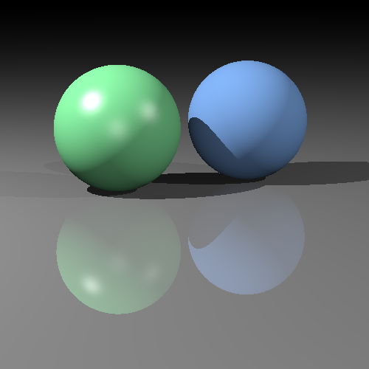
Until Now
We assumed that objects have fixed R, G, B reflectance values
Surface orientation and light direction determined the shading of objects
Our best image so far is something like:

Slide 3
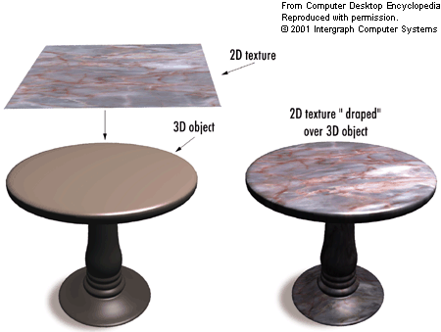
Texture Mapping
Goal: Increase visual realism by using images to simulate reflectance characteristics of objects.
A cheap and effective way to spatially vary surface reflectance.
From http://img.tfd.com

Slide 4
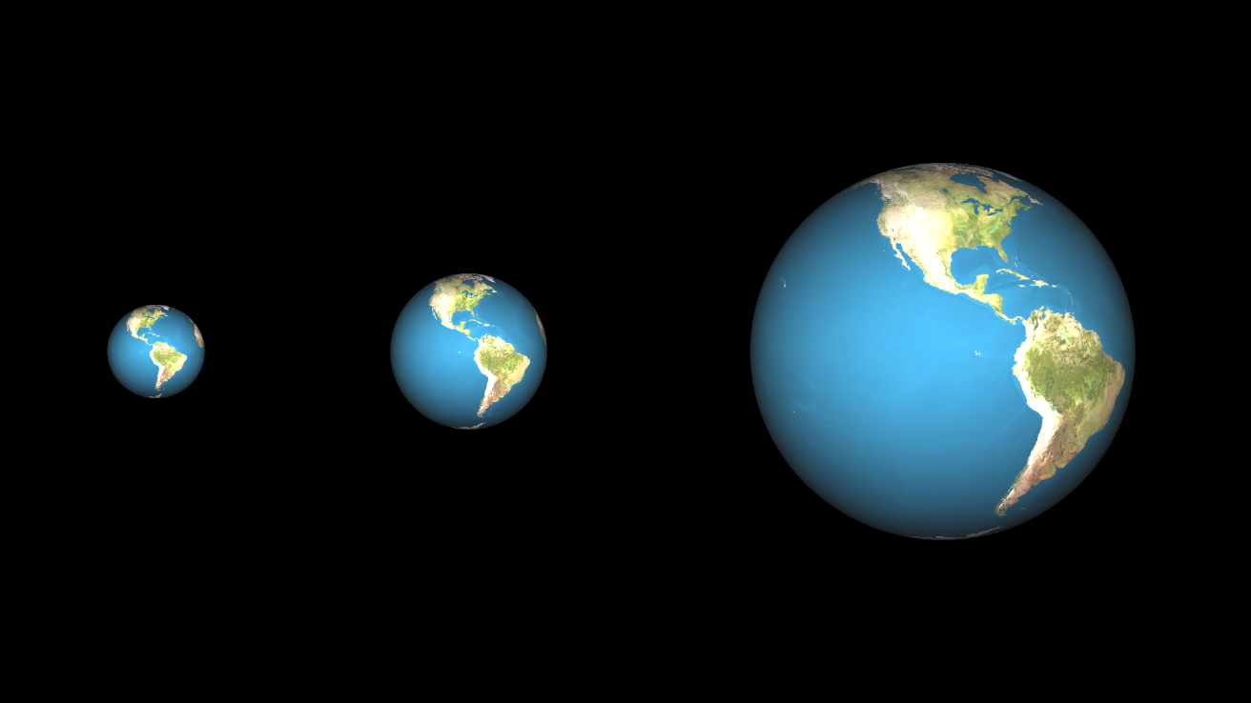
Texture Mapping
Image (texture) sizes and object sizes may vary
We need a uniform way so that any object can be mapped by any texture

Slide 5
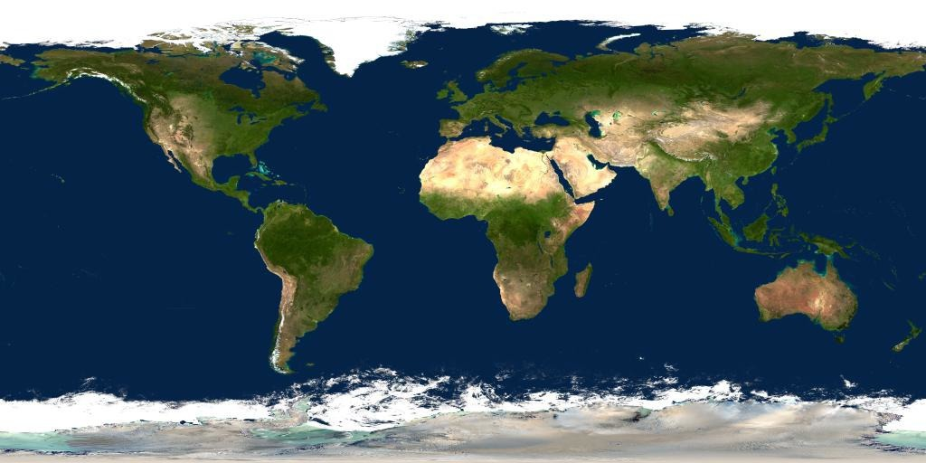
Texture Mapping
Step 1: Associate a (u, v) coordinate system with the texture image where (u, v) ∈ [0,1]x[0,1]
u
v

Slide 6
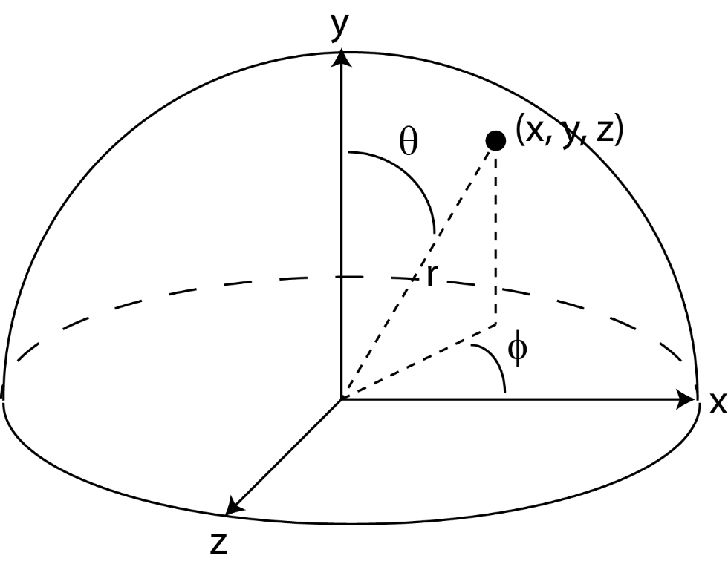
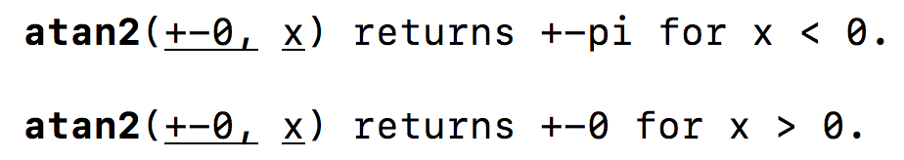
Texture Mapping
Step 2: Parameterize the surface to be texture mapped using two coordinates. For instance, a sphere:
Assuming that the center is at (0, 0, 0):
x = rsinΘcosϕ
y = rcosΘ
z = rsinΘsinϕ
Θ = arccos(y / r)
-π
0
ϕ = arctan(z / x)
π
0
In practice, ϕ = atan2(z, x)
(Θ, ϕ) ∈ [0, π]x[-π, π]

Slide 7
Texture Mapping
Assume you want to wrap the image such that:
u = (-ϕ + π) / (2π)
v = Θ / π

Slide 8
Texture Mapping
Step 3: Compute a (u, v) value for every surface point. For instance, a sphere:
Step 4: Find the texture image coordinate (i, j) at the given (u, v) coordinate:
u = (-ϕ + π) / (2π)
v = Θ / π
i = u.n_{x}
Note that i, j can be fractional!
j = v.n_{y}
n_{x} = texture image width
n_{y} = texture image height

Slide 9
Texture Mapping
Step 5: Choose the texel color using a suitable interpolation strategy
Nearest Neighbor: fetch texel at nearest coordinate (faster)
Color(x, y, z) = fetch(round(i, j))
Bilinear Interpolation: Average four closest neighbors (smoother):
p = floor(i)
q = floor(j)
dx = i – p
dy = j - q
Color(x, y, z) = fetch(p, q).(1 – dx).(1 – dy) +
fetch(p+1, q).(dx).(1 – dy) +
fetch(p, q+1).(1 – dx).(dy) +
fetch(p+1, q+1).(dx).(dy)
(i,j)
dy
dx
(p,q)

Slide 10
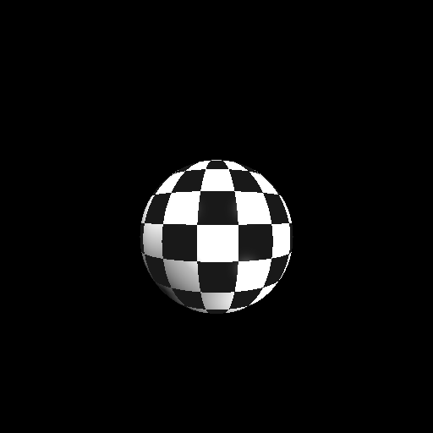
NN vs Bilinear Interpolation
Nearest-neighbor

Slide 11

NN vs Bilinear Interpolation
Bilinear

Slide 12
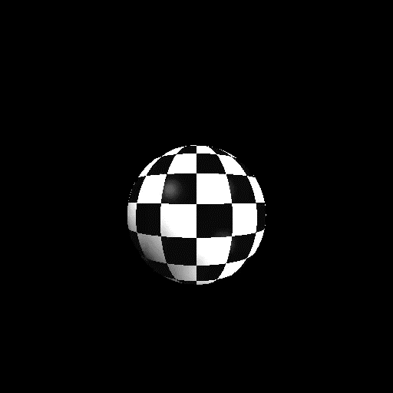

NN vs Bilinear Interpolation
Nearest-neighbor
Bilinear

Slide 13
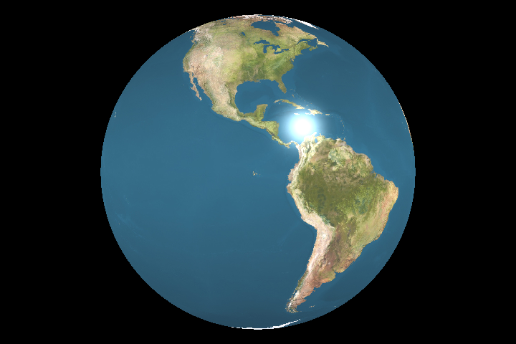
Texture Color
Once we have the texture color, what to do with it?
Several options possible: replace shading color, blend with shading color, replace k_{d} component, etc.

Slide 14
Texture Color
For instance, to replace the k_{d} component:
w_{i}
n
$$L_{o}^{d}(x,wo)=kdcosθ^{′}Ei\left(x, wi\right)$$
w_{o}
Θ
Outgoing
radiance
Received
irradiance
x
$$cosθ′=max⁡(0, wi.n)$$
where
k_{d} = textureColor / 255

Slide 15
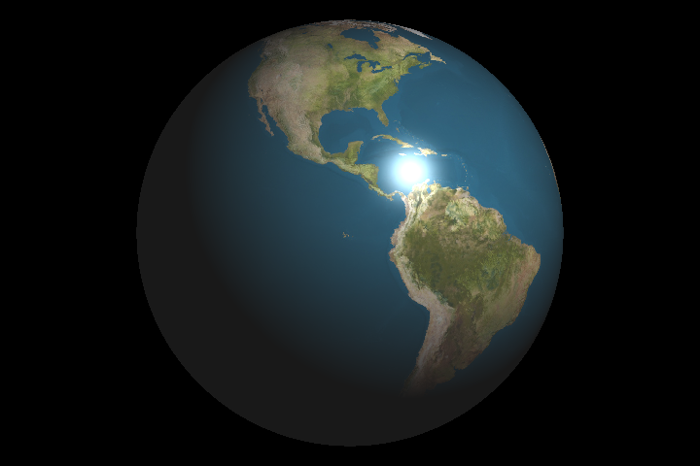
Texture Color
Replacing k_{d} typically improves realism over replacing the entire diffuse color:
Diffuse color replaced
k_{d} component replaced

Slide 16
Texture Mapping Triangles
First, we must associate (u, v) coordinates for each vertex
The (u, v) coordinates inside the triangle can be found using the barycentric coordinates
Recall that the position of point p at barycentric coordinates (β, γ) is equal to:
p(β, γ) = a + β(b – a) + γ(c – a)
Texture coordinates can be interpolated similarly:
u(β, γ) = u_{a} + β(u_{b} – u_{a}) + γ(u_{c} – u_{a})
v(β, γ) = v_{a} + β(v_{b} – v_{a}) + γ(v_{c} – v_{a})

Slide 17
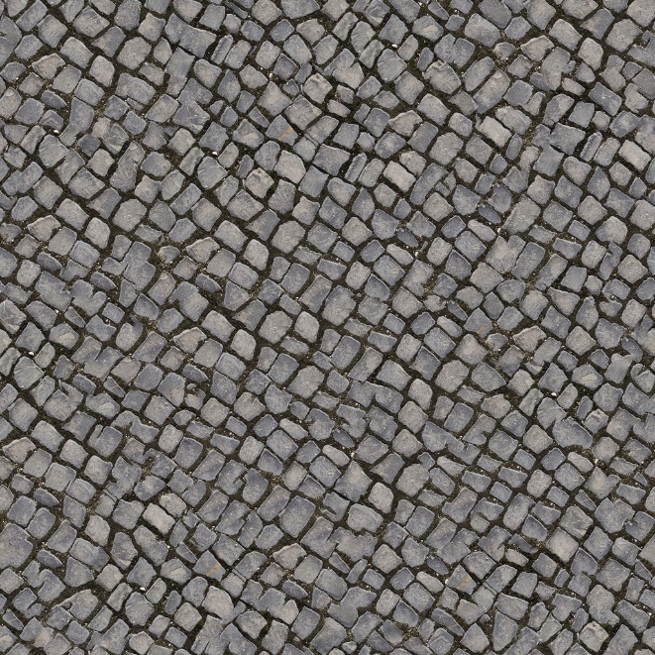
Texture Mapping Triangles
Assume we want the texture map a rectangle made of two triangles:
v₃, v₁, v₂
v₁, v₃, v₀
(0, 0)
Texture image
(1, 0)
v₀
v₃
v₁
v₂
(0, 1)
(1, 1)

Slide 18
Texture Mapping Triangles
We associate a texture coordinate with each vertex of each triangle:
v₃, v₁, v₂: (1, 0), (0, 1), (1, 1)
v₁, v₃, v₀: (0, 1), (1, 0), (0, 0)
(0, 0)
Texture image
(1, 0)
v₀
v₃
v₁
v₂
(0, 1)
(1, 1)

Slide 19
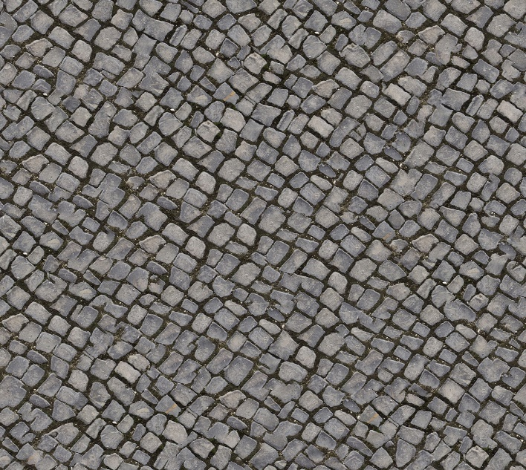
Texture Mapping Triangles
This way, the texture image gets stretched to match the triangles’ positions
v₃, v₁, v₂: (1, 0), (0, 1), (1, 1)
v₁, v₃, v₀: (0, 1), (1, 0), (0, 0)
v₀
v₃
v₁
v₂

Slide 20
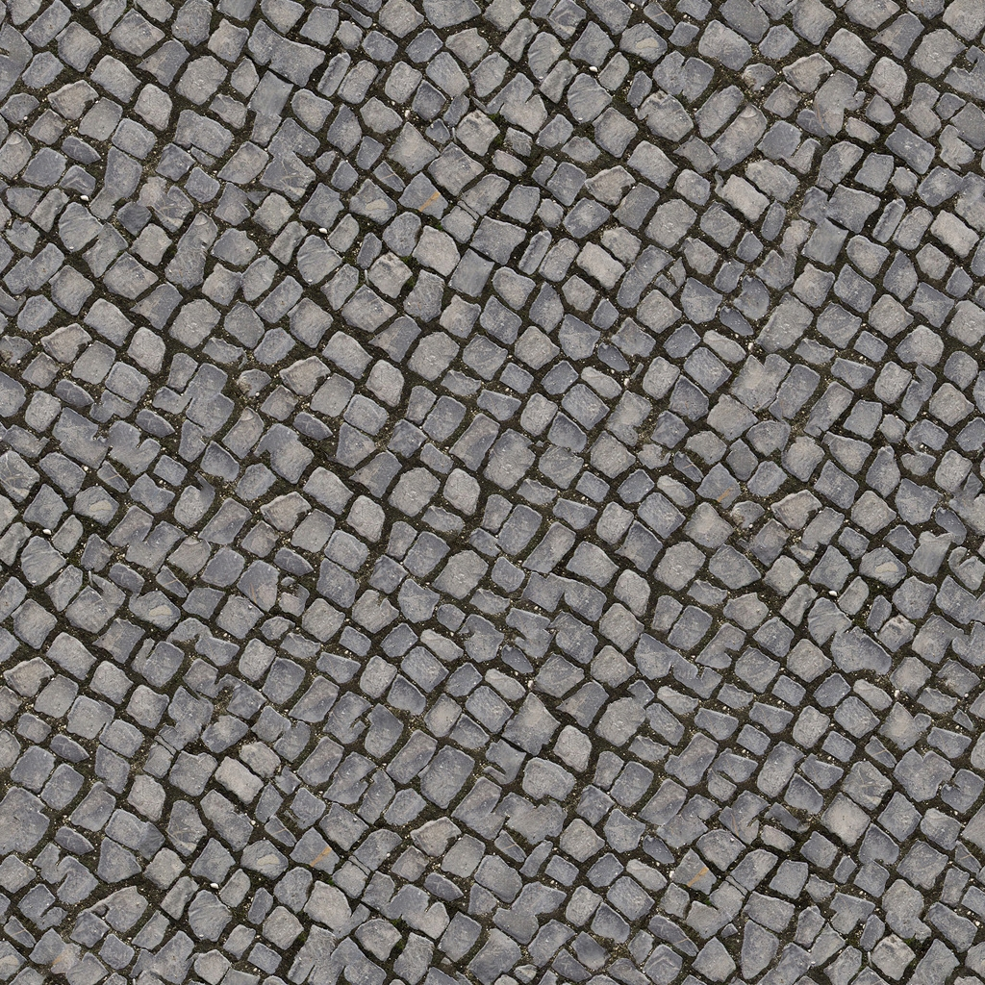
Tiling
For large surfaces, stretching may excessively distort the texture image making it unrealistic

Slide 21
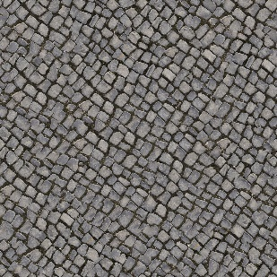
Tiling
Tiling is the process of repeating a texture instead of stretching
Multiple copies of the texture fill the surface
Tiling may also look unrealistic if repetition is clear
1
2
3
4
5
6
7
8
9
10
11
12

Slide 22
Tiling
To support tiling, tex. coords. are not limited to [0, 1] range
(0, 0)
(6, 0)
u = u_{barycentric} – floor(u_{barycentric})
v = v_{barycentric} – floor(v_{barycentric})
(0, 2)
(6, 2)

Slide 23
Textures Atlases
Most objects in CG will have a texture applied to it
This requires using multiple textures, sometimes thousands or more, for a moderately complex environment
Many times text is also retrieved from texture images
Instead of using multiple texture, a texture atlas combines textures of many objects into a single image

Slide 24
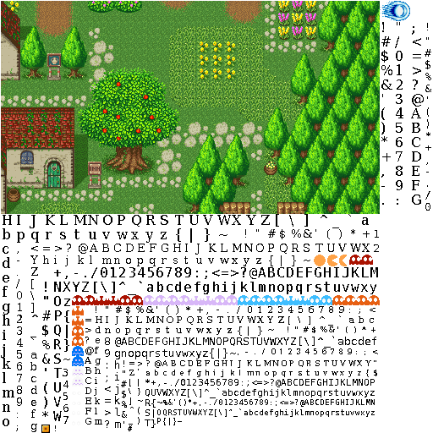
Textures Atlases
http://jeapostrophe.github.io/2013-05-06-texture--post.html

Slide 25
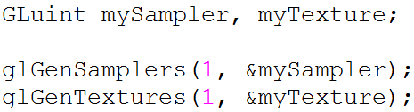
Texture Mapping using OpenGL
Step 1: Generate a name for your texture and sampler:
these are just handles to refer to your texture and sampler

Slide 26
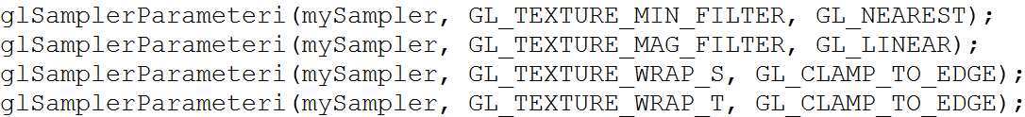
Texture Mapping using OpenGL
Step 2: Set your sampling parameters:
What to do if your texture
needs to be minified
What to do if your texture
needs to be magnified
What to do if you make
out-of-bounds access

Slide 27
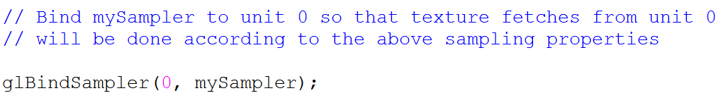
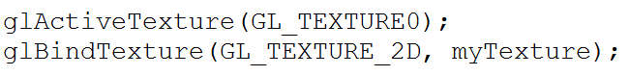
Texture Mapping using OpenGL
Step 3: Bind your sampler to the desired texture unit:
Step 4: Activate the desired unit and bind your texture to the proper target of that unit as well

Slide 28
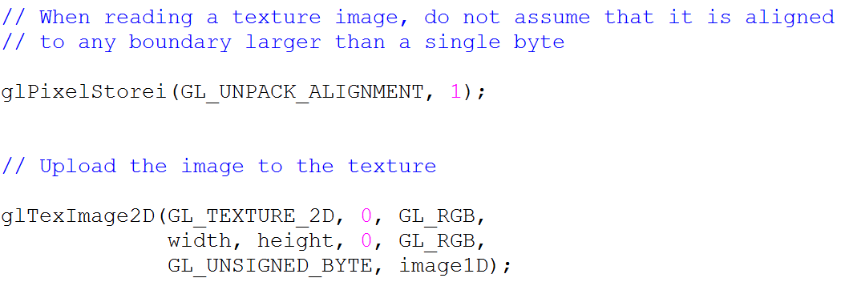
Texture Mapping using OpenGL
Step 5: Read the texture image from an image file (.jpg, .png, etc.) into a one dimensional array and tell OpenGL about the address of this array:
Pointer to the
first byte of your
image

Slide 29
Texture Mapping using OpenGL
At this point we have the following picture:
1D
Sampler
Texture Unit 0
2D
Image
3D
Texture Unit 1
Not activated

Slide 30
Texture Mapping using OpenGL
Step 6: Provide uv coordinates for each vertex
In immediate mode you can use: glTexCoord2f
If using vertex arrays, we must provide the texture coordinates in an array (as we did for vertex positions, colors, etc.)
glTexCoordPointer or glVertexAttribPointer
As before, this array can be on the system memory or uploaded to GPU memory (remember VBOs)
glTexCoordPointer(size, type, stride, pointer)
Pointer to texture
vertex coordinate
data
Number of coordinates
per texture vertex
Type of each
coordinate
Byte offset between
consecutive texture vertices

Slide 31
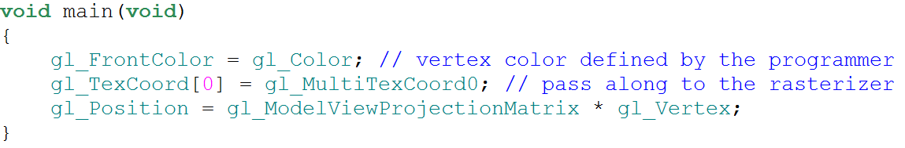
Texture Mapping using OpenGL
Step 7: In the vertex shader, pass along these texture coordinates to the rasterizer:
This is a built-in varying variable
which will be automatically interpolated
This value comes from the
vertex array whose data
is provided by glColorPointer
This value comes from the
vertex array whose data
is provided by glTexCoordPointer
This value comes from the
vertex array whose data
is provided by glVertexPointer

Slide 32
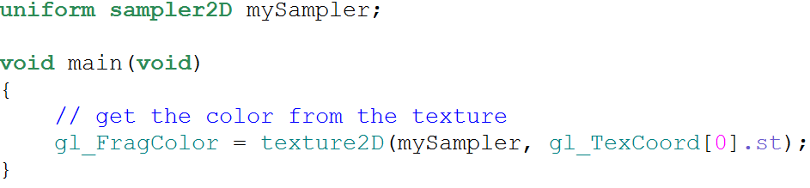
Texture Mapping using OpenGL
Step 8: In the fragment shader, fetch from the texture image using a suitable sampling method:
This variable represents the texture unit index. If its value is zero it will fetch from texture unit 0. Its value is given such as glUniform1i(mySamplerLoc, 0)

Slide 33
Texture Mapping using OpenGL
At this point we have the following picture:
1D
Sampler
Texture Unit 0
2D
Image
3D
Texture Unit 1
mySampler
Not activated

Slide 34
Texture Mapping using OpenGL
If we call glUniform1i(mySamplerLoc, 1):
1D
Sampler
Texture Unit 0
2D
Image
3D
Texture Unit 1
mySampler
Not activated

Slide 35
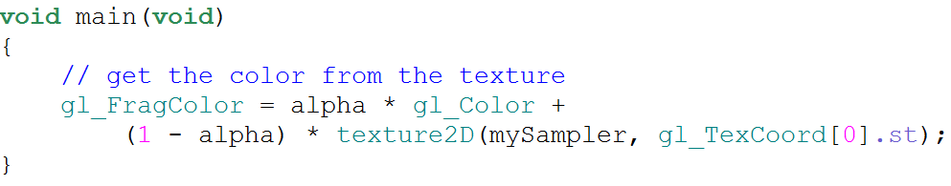
Texture Mapping using OpenGL
What to do once we have the texture color? We have several options
For instance to blend the texture color with the color of the fragment:
Interpolated color value
User-defined interpolation
parameter. Can be a uniform. Can also be read from the texture if it has a alpha channel

Slide 36
Sampling
Sampling is the process of fetching the value from a texture image given its texture coordinate
Nearest-neighbor and bilinear interpolation are two examples
Need to tell OpenGL about the type of sampling we want
Previously we set sampling parameters using:
There is another important concept called mipmapping

Slide 37
Mipmapping
Mipmapping deals with cases when the resolution of the primitive is different from the resolution of the texture (which often is the case)
Consider three cases where
The polygon that is texture mapped is the same size (in screen space) as the texture image
The polygon that is texture mapped is larger than the texture image
The polygon that is texture mapped is smaller than the texture image

Slide 38
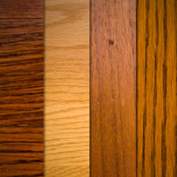
Mipmapping
Polygon same size as texture (map as usual):
Map
Polygon
Texture
Result

Slide 39
Mipmapping
Polygon larger (texture needs to be magnified):
Map
Result

Slide 40
Mipmapping
Polygon smaller (texture needs to be minified):
Map
Result

Slide 41
Mipmapping
Minification: A change of 1 pixel in image space causes a change of >1pixel in texture space
To avoid artifacts, one should use the average of all texels that should fall on the same image pixel
Map

Slide 42
Mipmapping
Take the extreme case: 1 pixel change in image space corresponds to as many pixels as the width of the texture in texture space:
For accurate mapping, this requires computing the average value of the entire row – otherwise aliasing artifacts will occur
Map

Slide 43
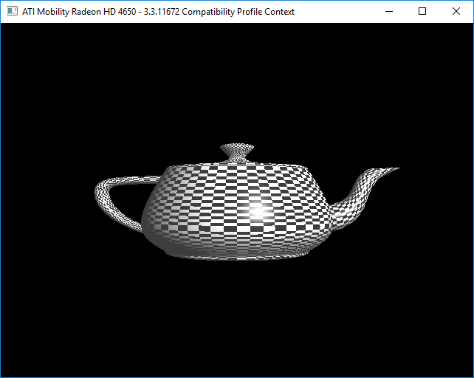
Aliasing

Slide 44
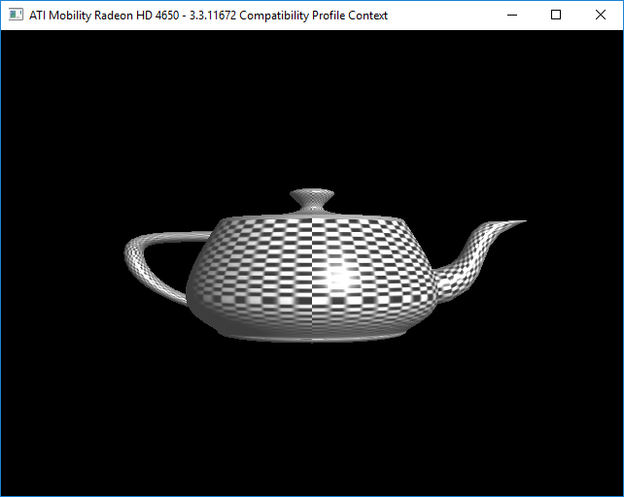
Anti-Aliased Result

Slide 45
Fixing Aliasing
Aliasing artifacts are even more disturbing if animation is present in the scene
Aliasing artifacts occur as we are sampling a high frequency texture at very low frequencies
Our sample does not faithfully represent the real signal
It adopts a different persona – thus called aliasing
Sampling at a higher rate is not an option as samples are determined by our fragments
Solution: Reduce the frequency of the original signal by low-pass filtering (blurring)
Problem: Expensive to continuously filter in runtime

Slide 46
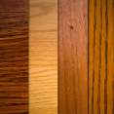
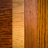
Mipmapping
Solution: Pre-filter images to create smaller resolution versions during initialization (or offline):
Then sample from the appropriate resolution in runtime
Memory requirement – how much memory does a mipmap chain require?
A + A/4 + A/16 + A/64 + … = 4A/3

Slide 47
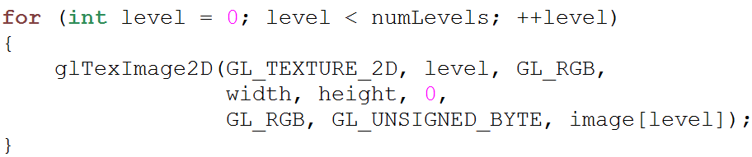
OpenGL Support
Mipmap levels can be created offline and then given to OpenGL. This allows custom filtering for each level:

Slide 48
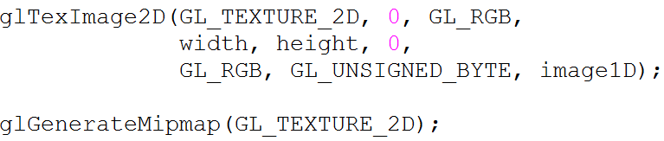
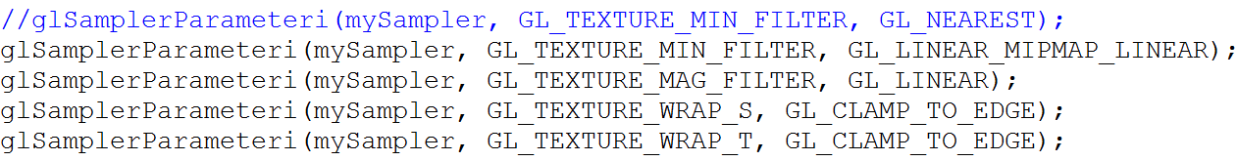
OpenGL Support
Alternatively, we can ask OpenGL to automatically generate mipmap levels for us:
To use mipmapping, we must set the sampler parameters correctly:
Notes:
After this show basic_multi_texture code sample

Slide 49
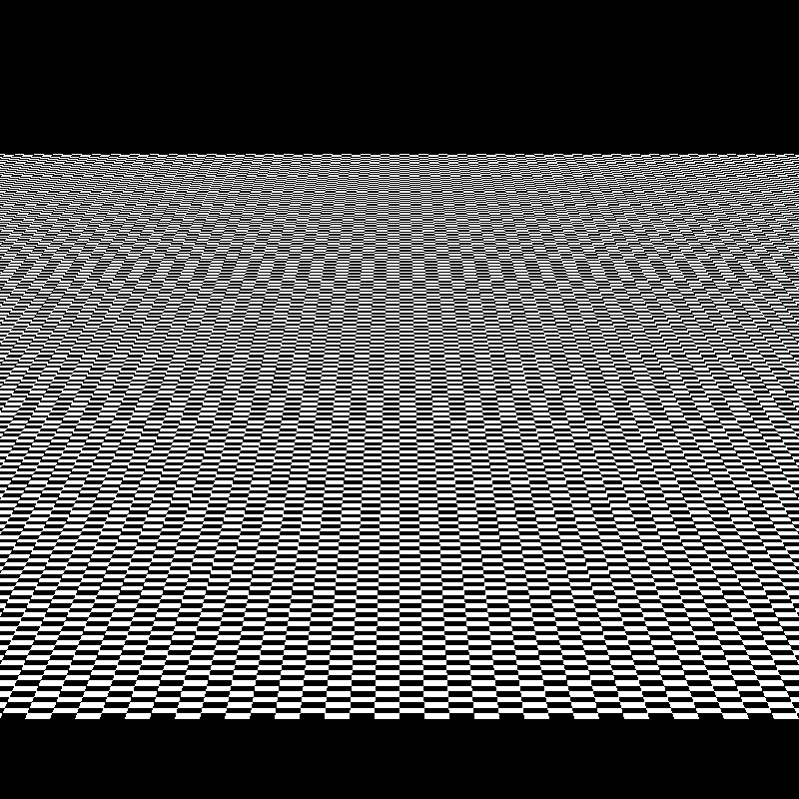
Results
Nearest

Slide 50
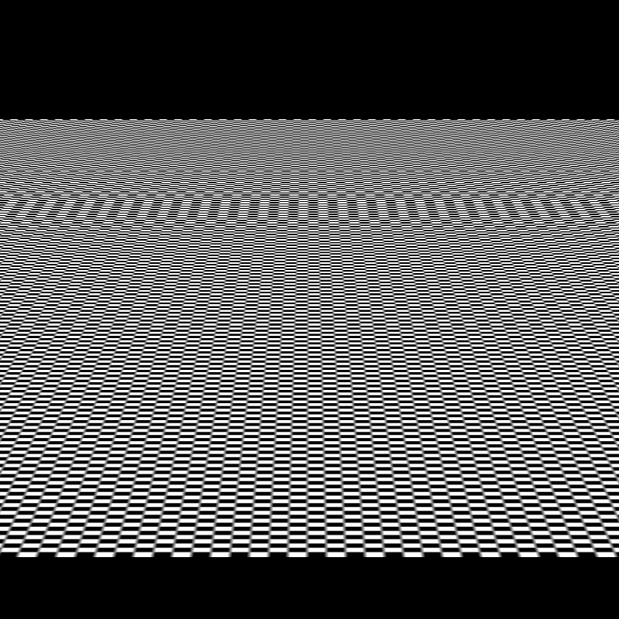
Results
Bilinear

Slide 51
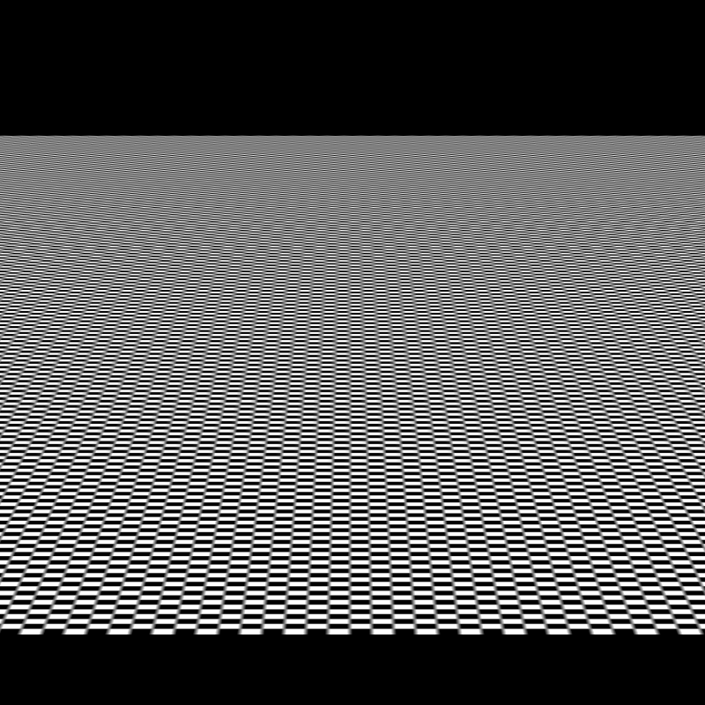
Results
Trilinear (mipmapping)

Slide 52
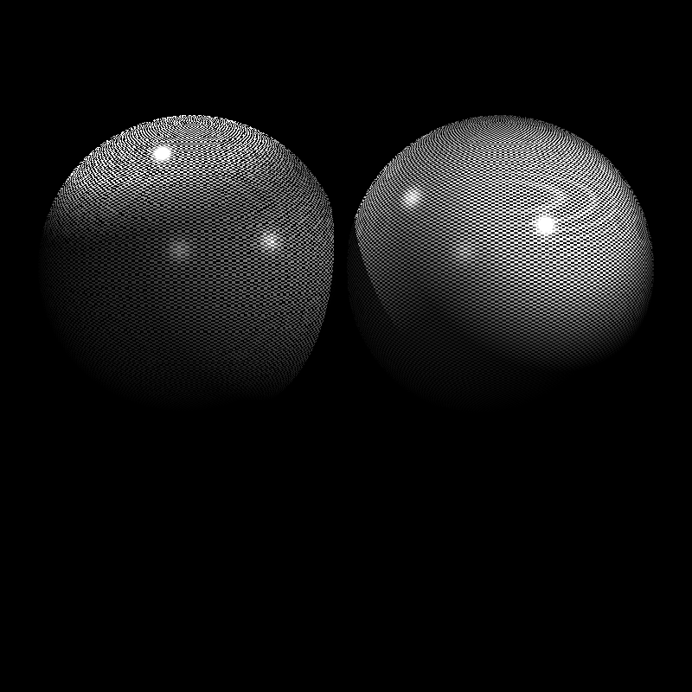
Results
Nearest vs. Bilinear

Slide 53
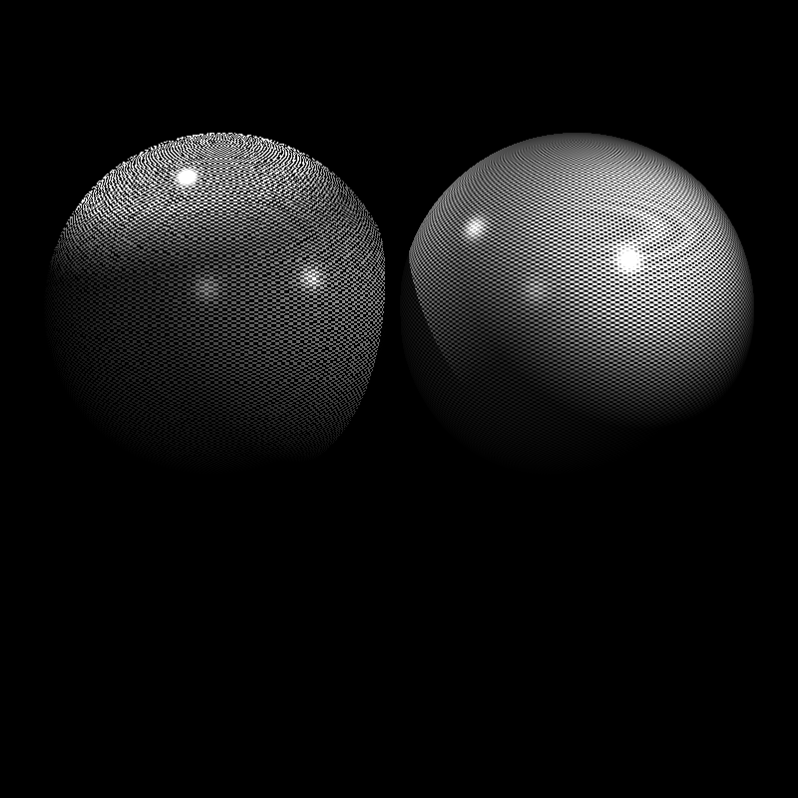
Results
Nearest vs. Trilinear

Slide 54
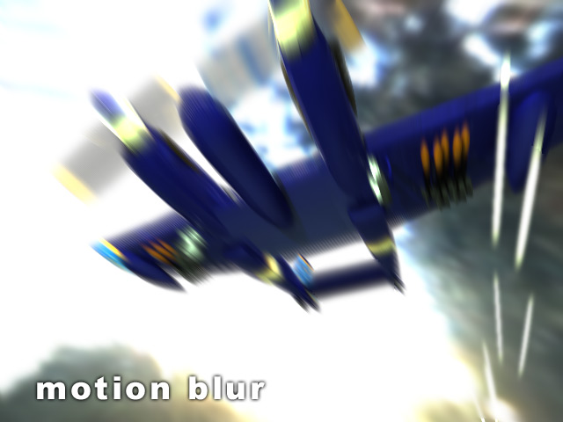
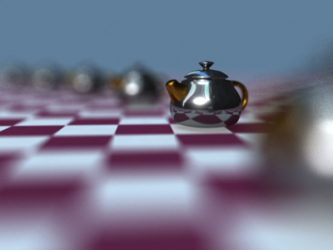
Framebuffer Objects
Until now, we always rendered to the screen
But many visual effects require rendering an image to an off-screen buffer and processing it before displaying it
Motion Blur
Depth of Field

Slide 55
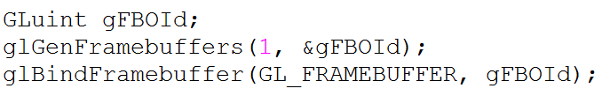
Framebuffer Objects
Framebuffer objects are designed to allow such effects
Step 1: To use an FBO you must first generate a name for it and bind it as the current framebuffer

Slide 56
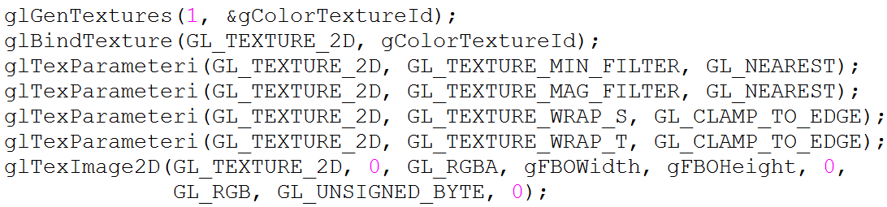
Framebuffer Objects
Step 2: Next we must allocate memory for its color and (optionally) depth buffers. These memories are allocated as textures
For color buffer:

Slide 57
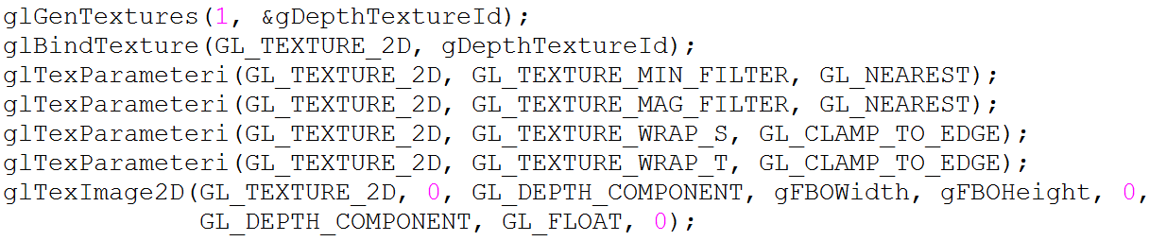
Framebuffer Objects
Step 2: Next we must allocate memory for its color and (optionally) depth buffers. These memories are allocated as textures
For depth buffer:

Slide 58
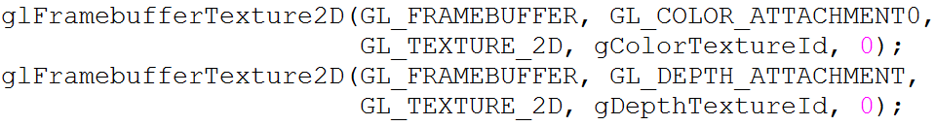
Framebuffer Objects
Step 3: We must attach these textures to the FBO:
Step 4: Make sure that FBO is complete:

Slide 59
Framebuffer Objects
When we render while this FBO is bound, the attached textures’ contents will be updated
Important: before rendering make sure that you set your viewport to match the resolution of this framebuffer using glViewport(0, 0, gFBOWidth, gFBOHeight)
This is needed as the size of the window (for which the viewport was originally set) can be different from the size of our FBO

Slide 60
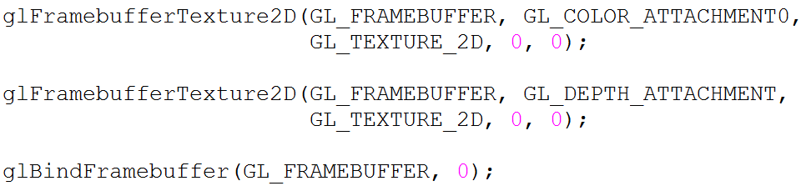
Framebuffer Objects
Once you make the FBO rendering pass, you can detach your textures and switch back to the default framebuffer:
Now you can use these textures as source textures for various special effects
One such usage is for generating shadows as we will learn next week
Notes:
Show basic_multi_texture_fbo example

Slide 61
Summary
Texture mapping is critical for improving visual quality of rendered images
Texture coordinates can be computed automatically for parametric surfaces like spheres
They can be provided by the user for triangular meshes
UV unwrapping is a partially automated technique for solving this problem for complex meshes (not covered in this class)
Mipmapping is a technique for reducing aliasing with small extra memory overhead
Textures can be both source or target (framebuffer objects)
Not at the same pass, though
Render into as target in the first pass, read them as source in the second pass

